Slide 1
EDA Project_Kings County
Hassan B.

Slide 2
<number>
1. Purpose
- Charles C. is our stake holder
- Interested in Buying and selling houses
- No limit on investment. Plenty of budget
- Willing to invest in big returns only !!!

Slide 3
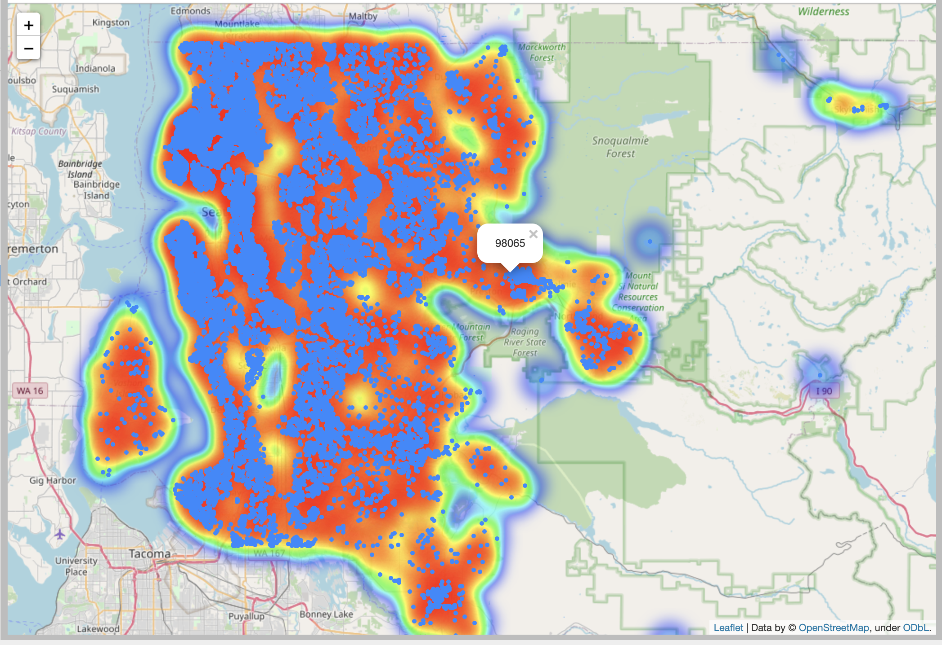
<number>
2. Exploring the locality

Slide 4
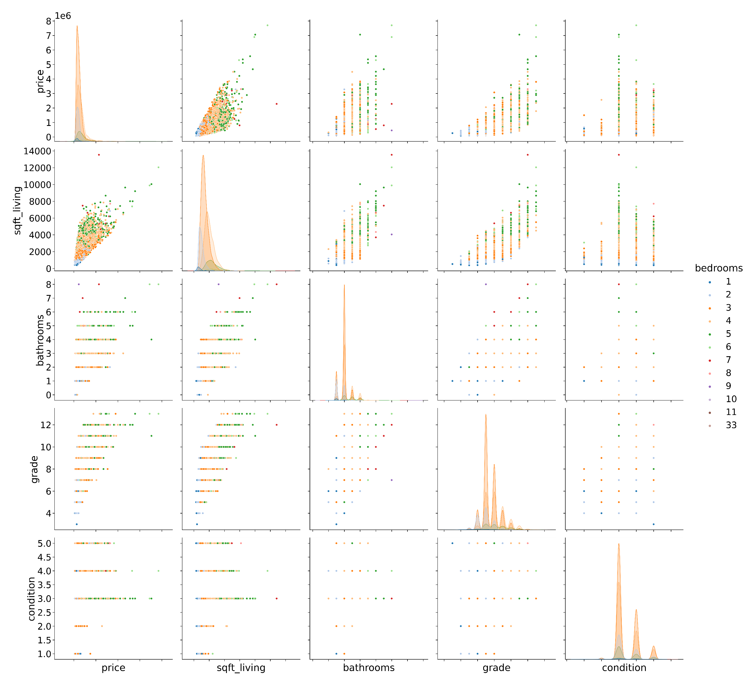
<number>
3. Analyzing the Data with plots

Slide 5
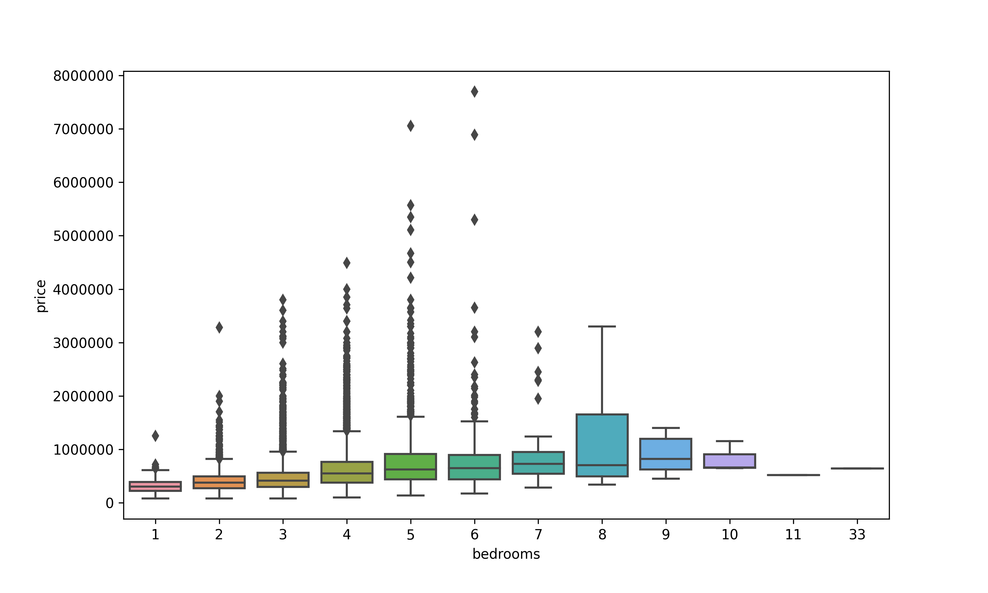
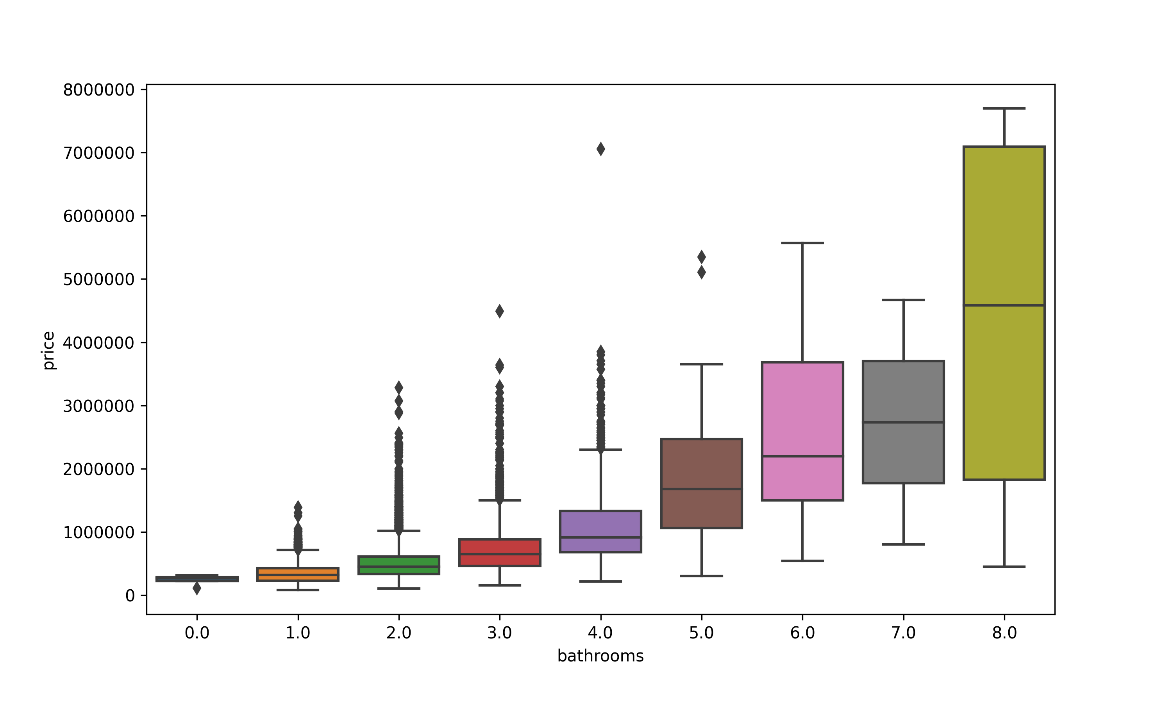
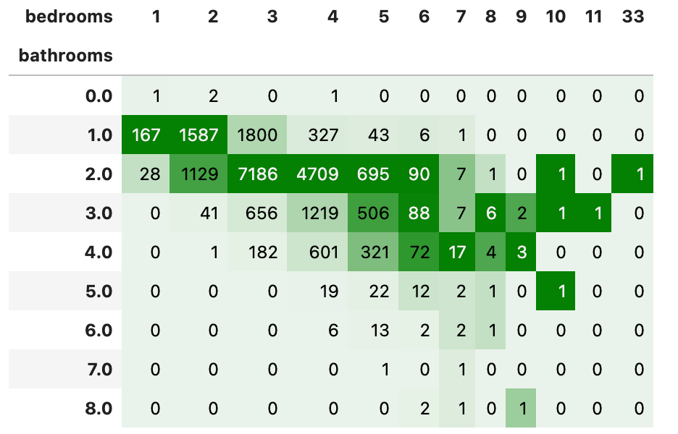
<number>
4. Analyzing the Data with plots

Slide 6
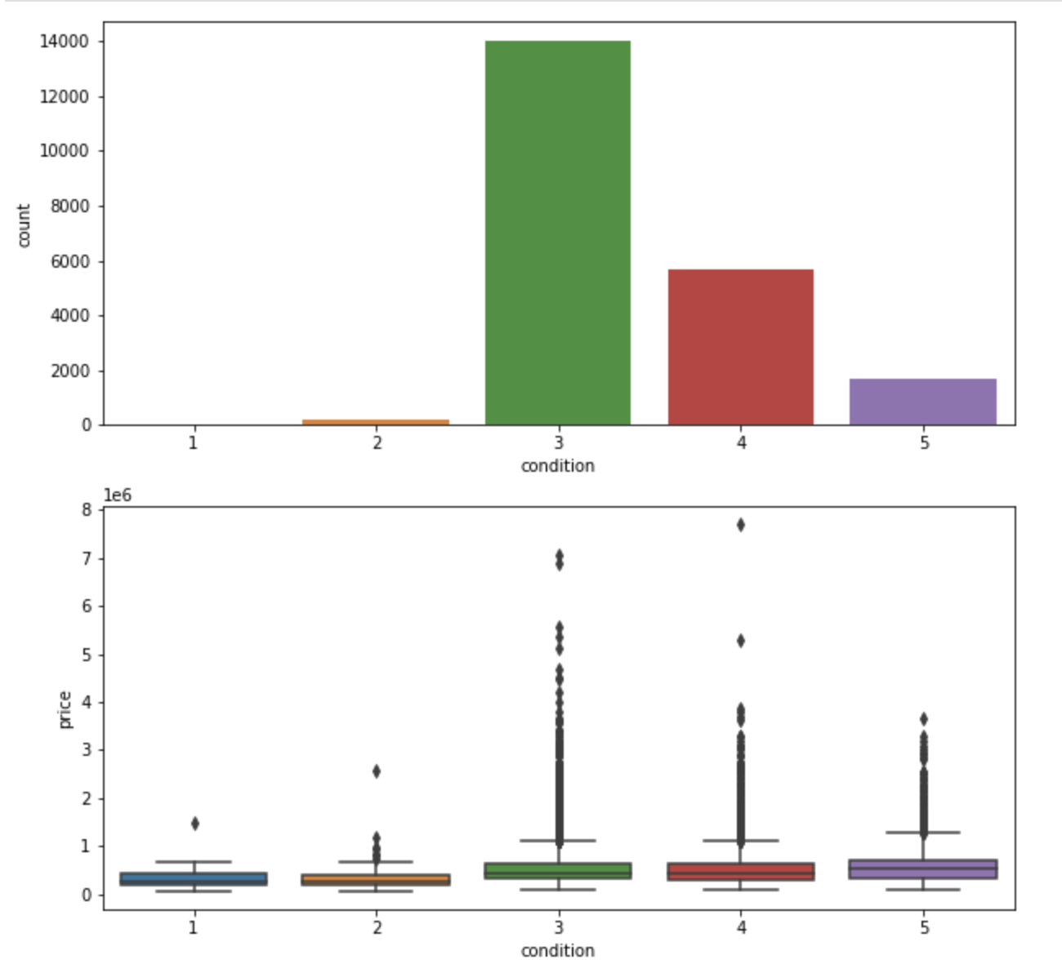
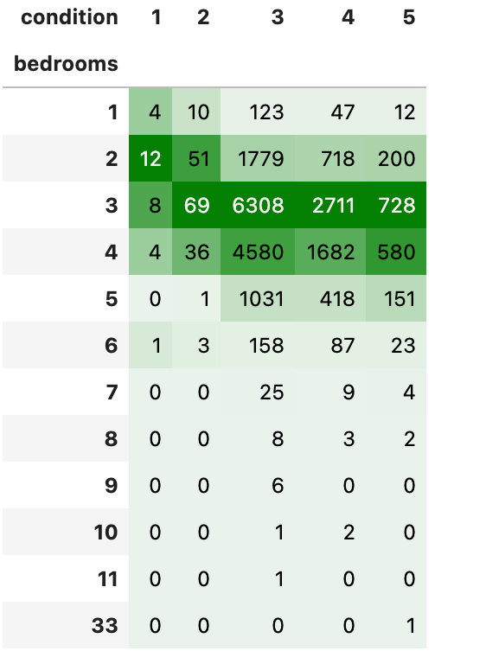
<number>
4. Analyzing the Data with plots

Slide 7
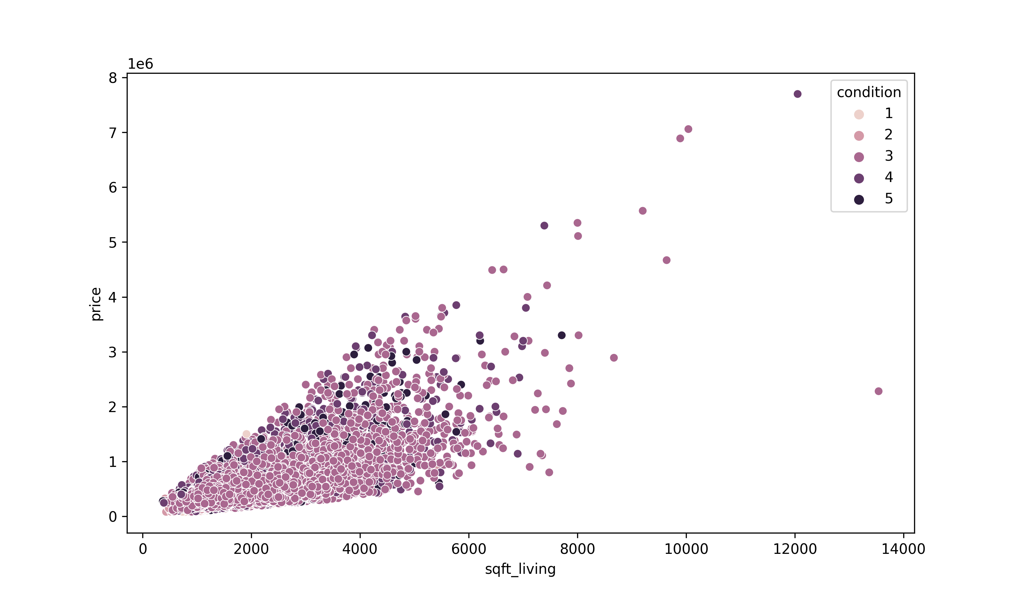
<number>
4. Analyzing the Data with plots

Slide 8
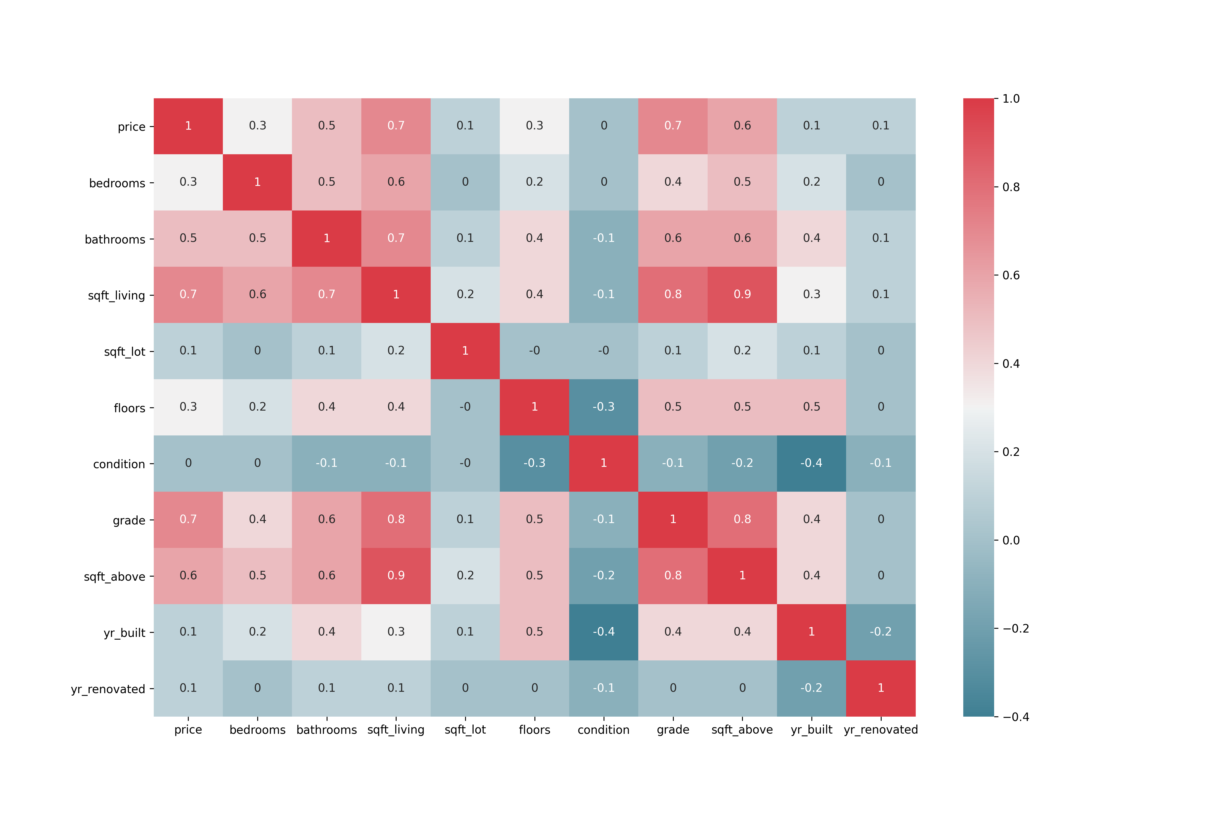
<number>
4. Analyzing the Data with plots

Slide 9
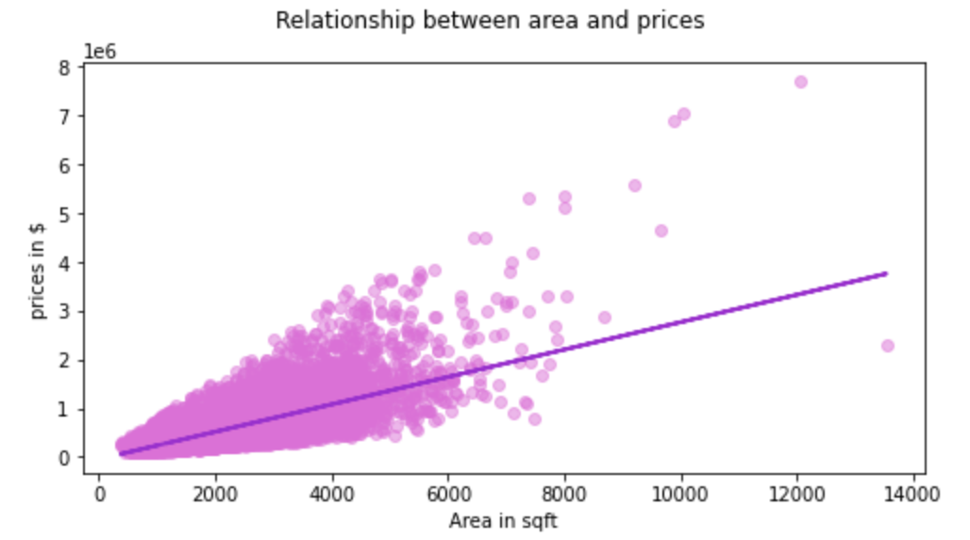
<number>
5. Regression modelling
R2 = 0.681

Slide 10
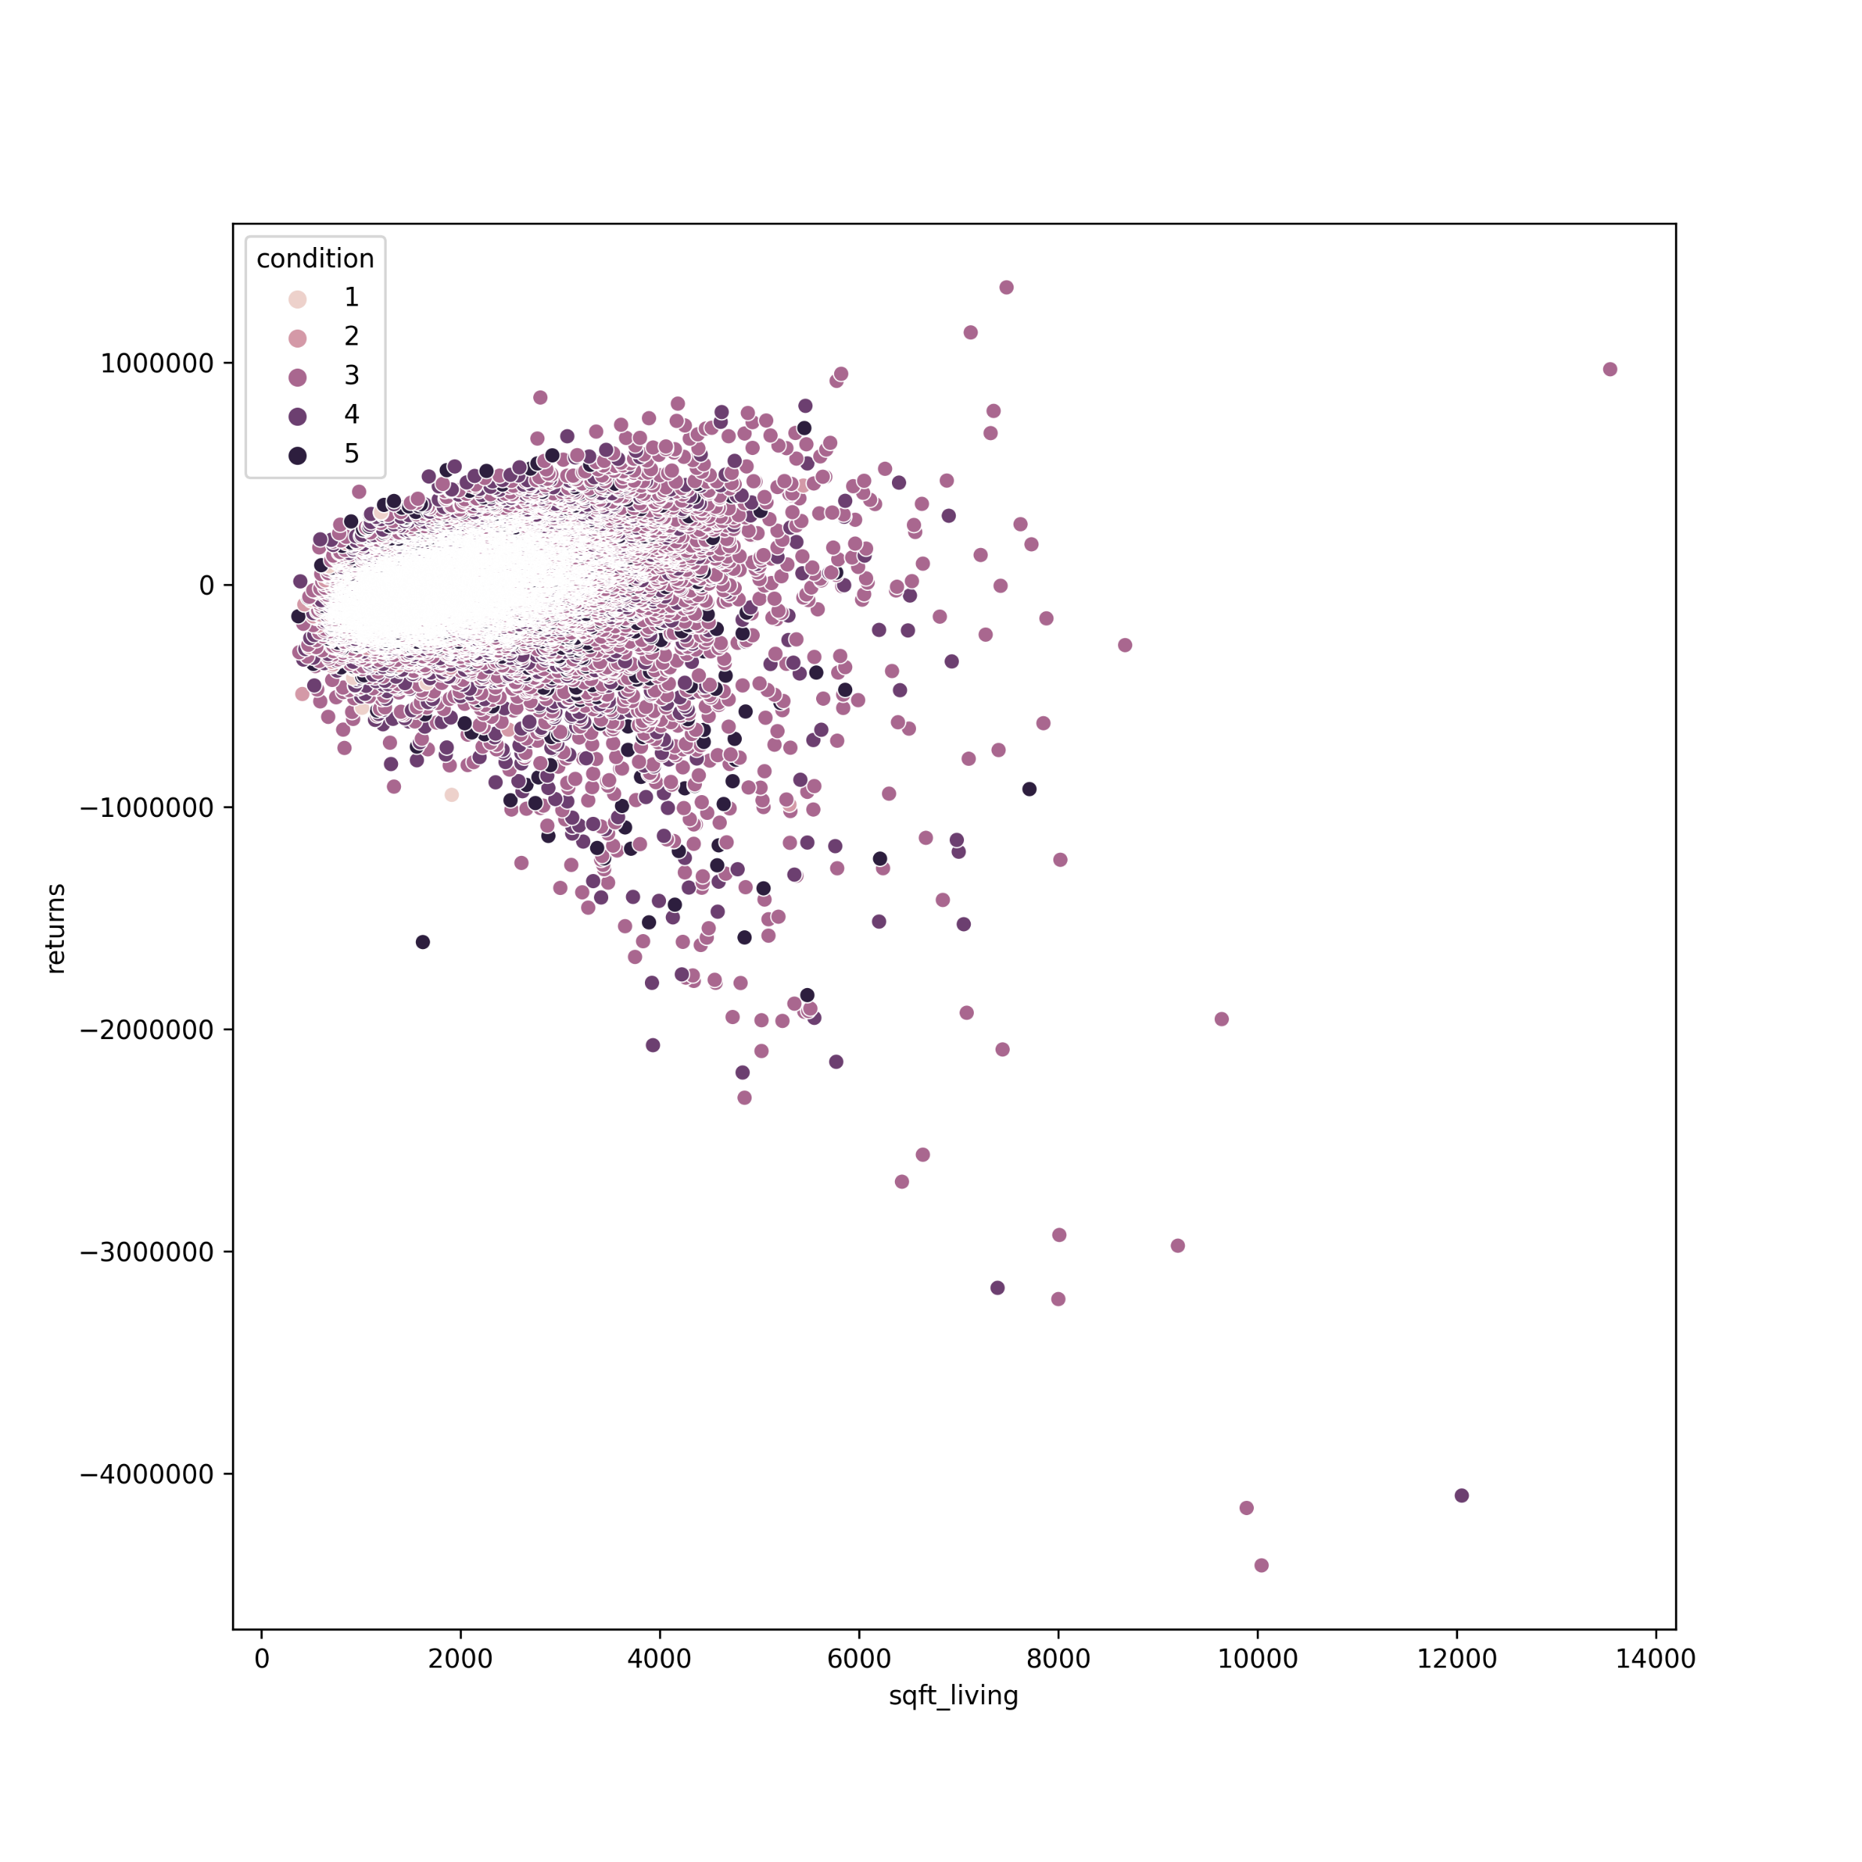
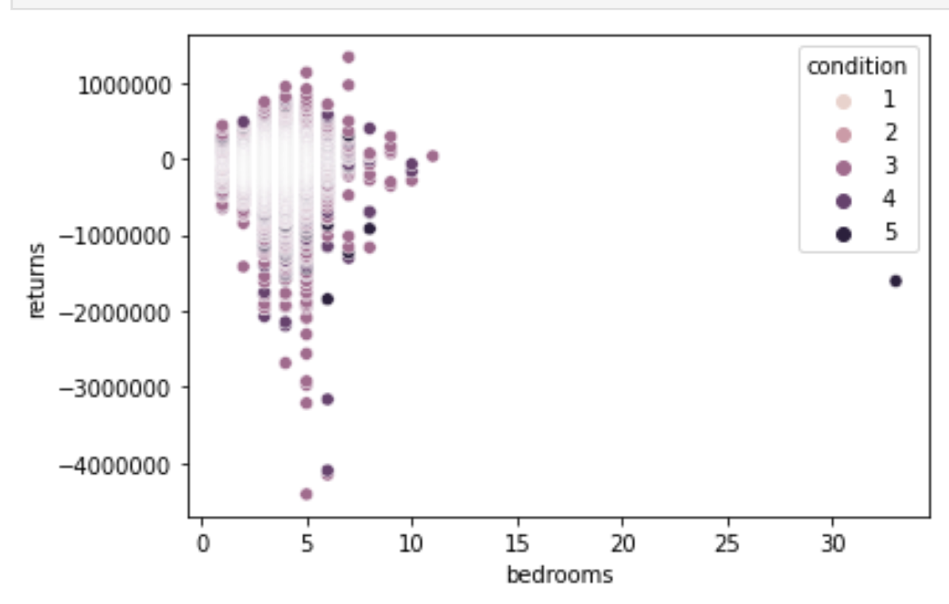
<number>
5. Regression modelling – Plotting the returns

Slide 11
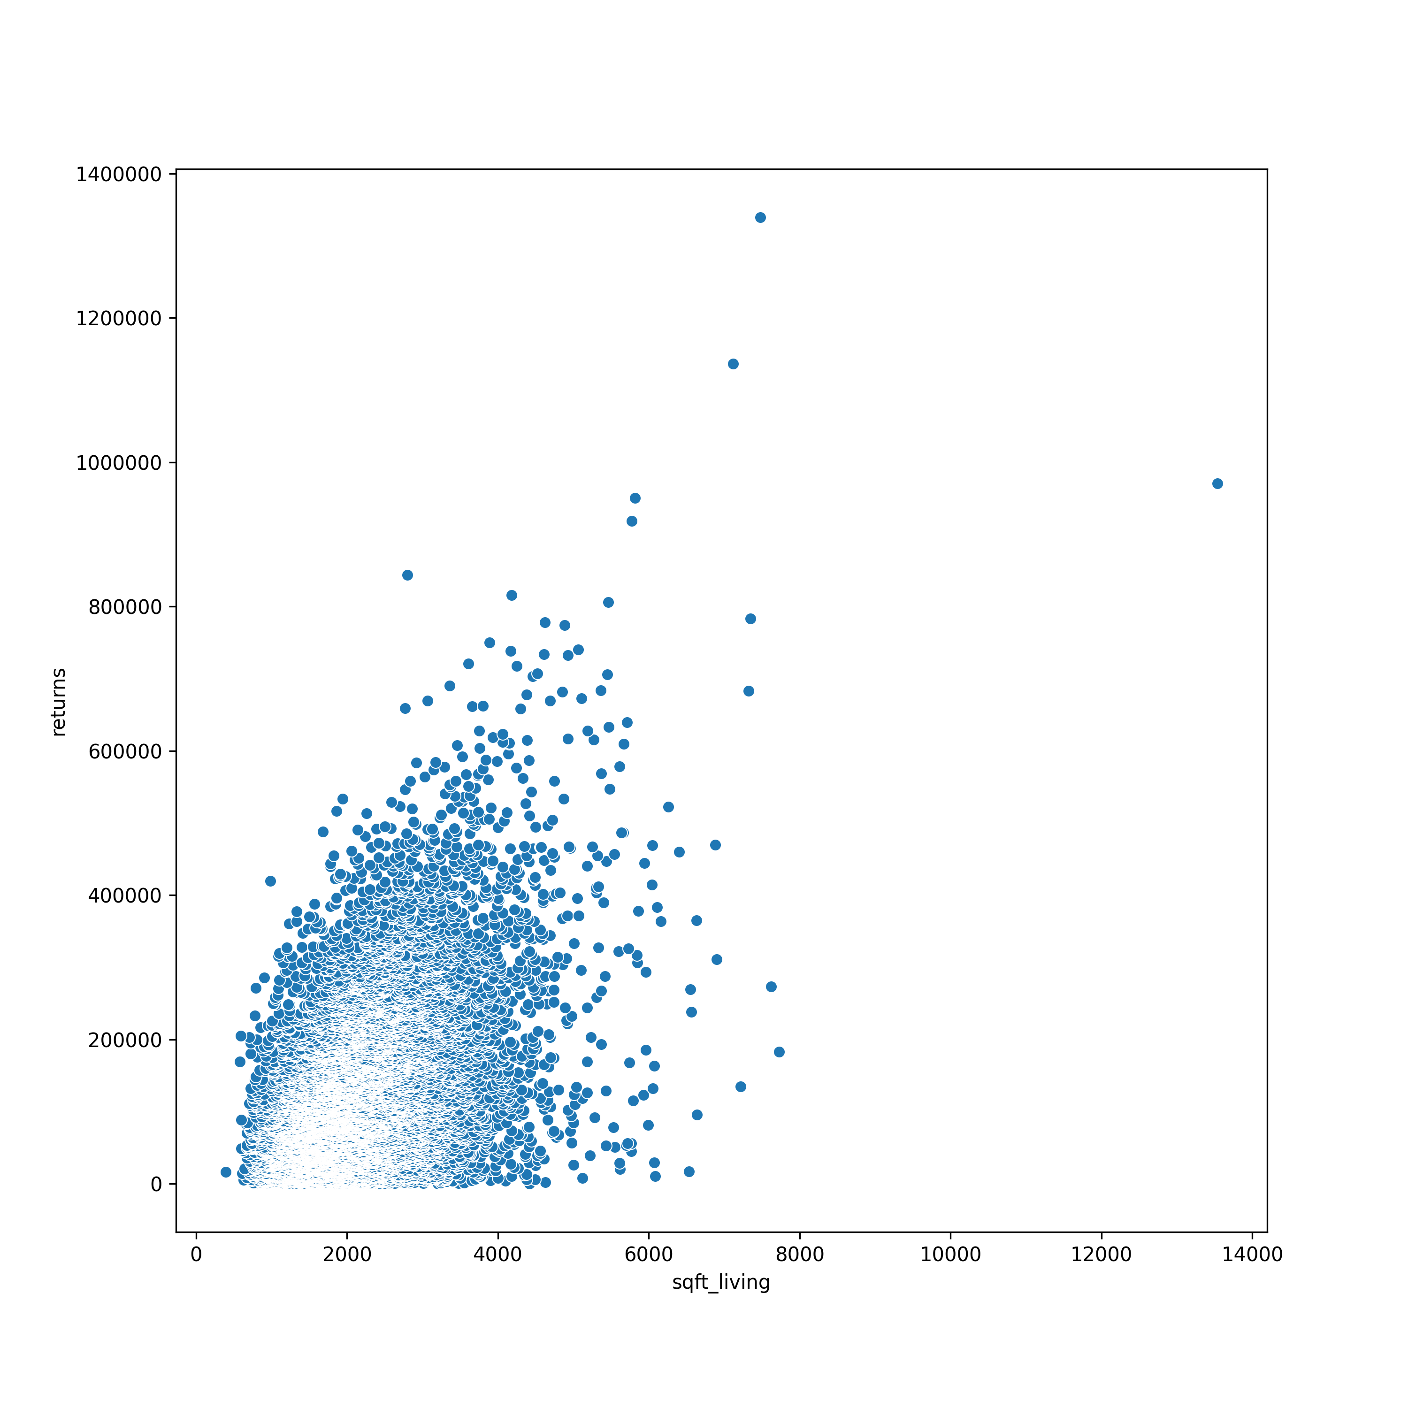
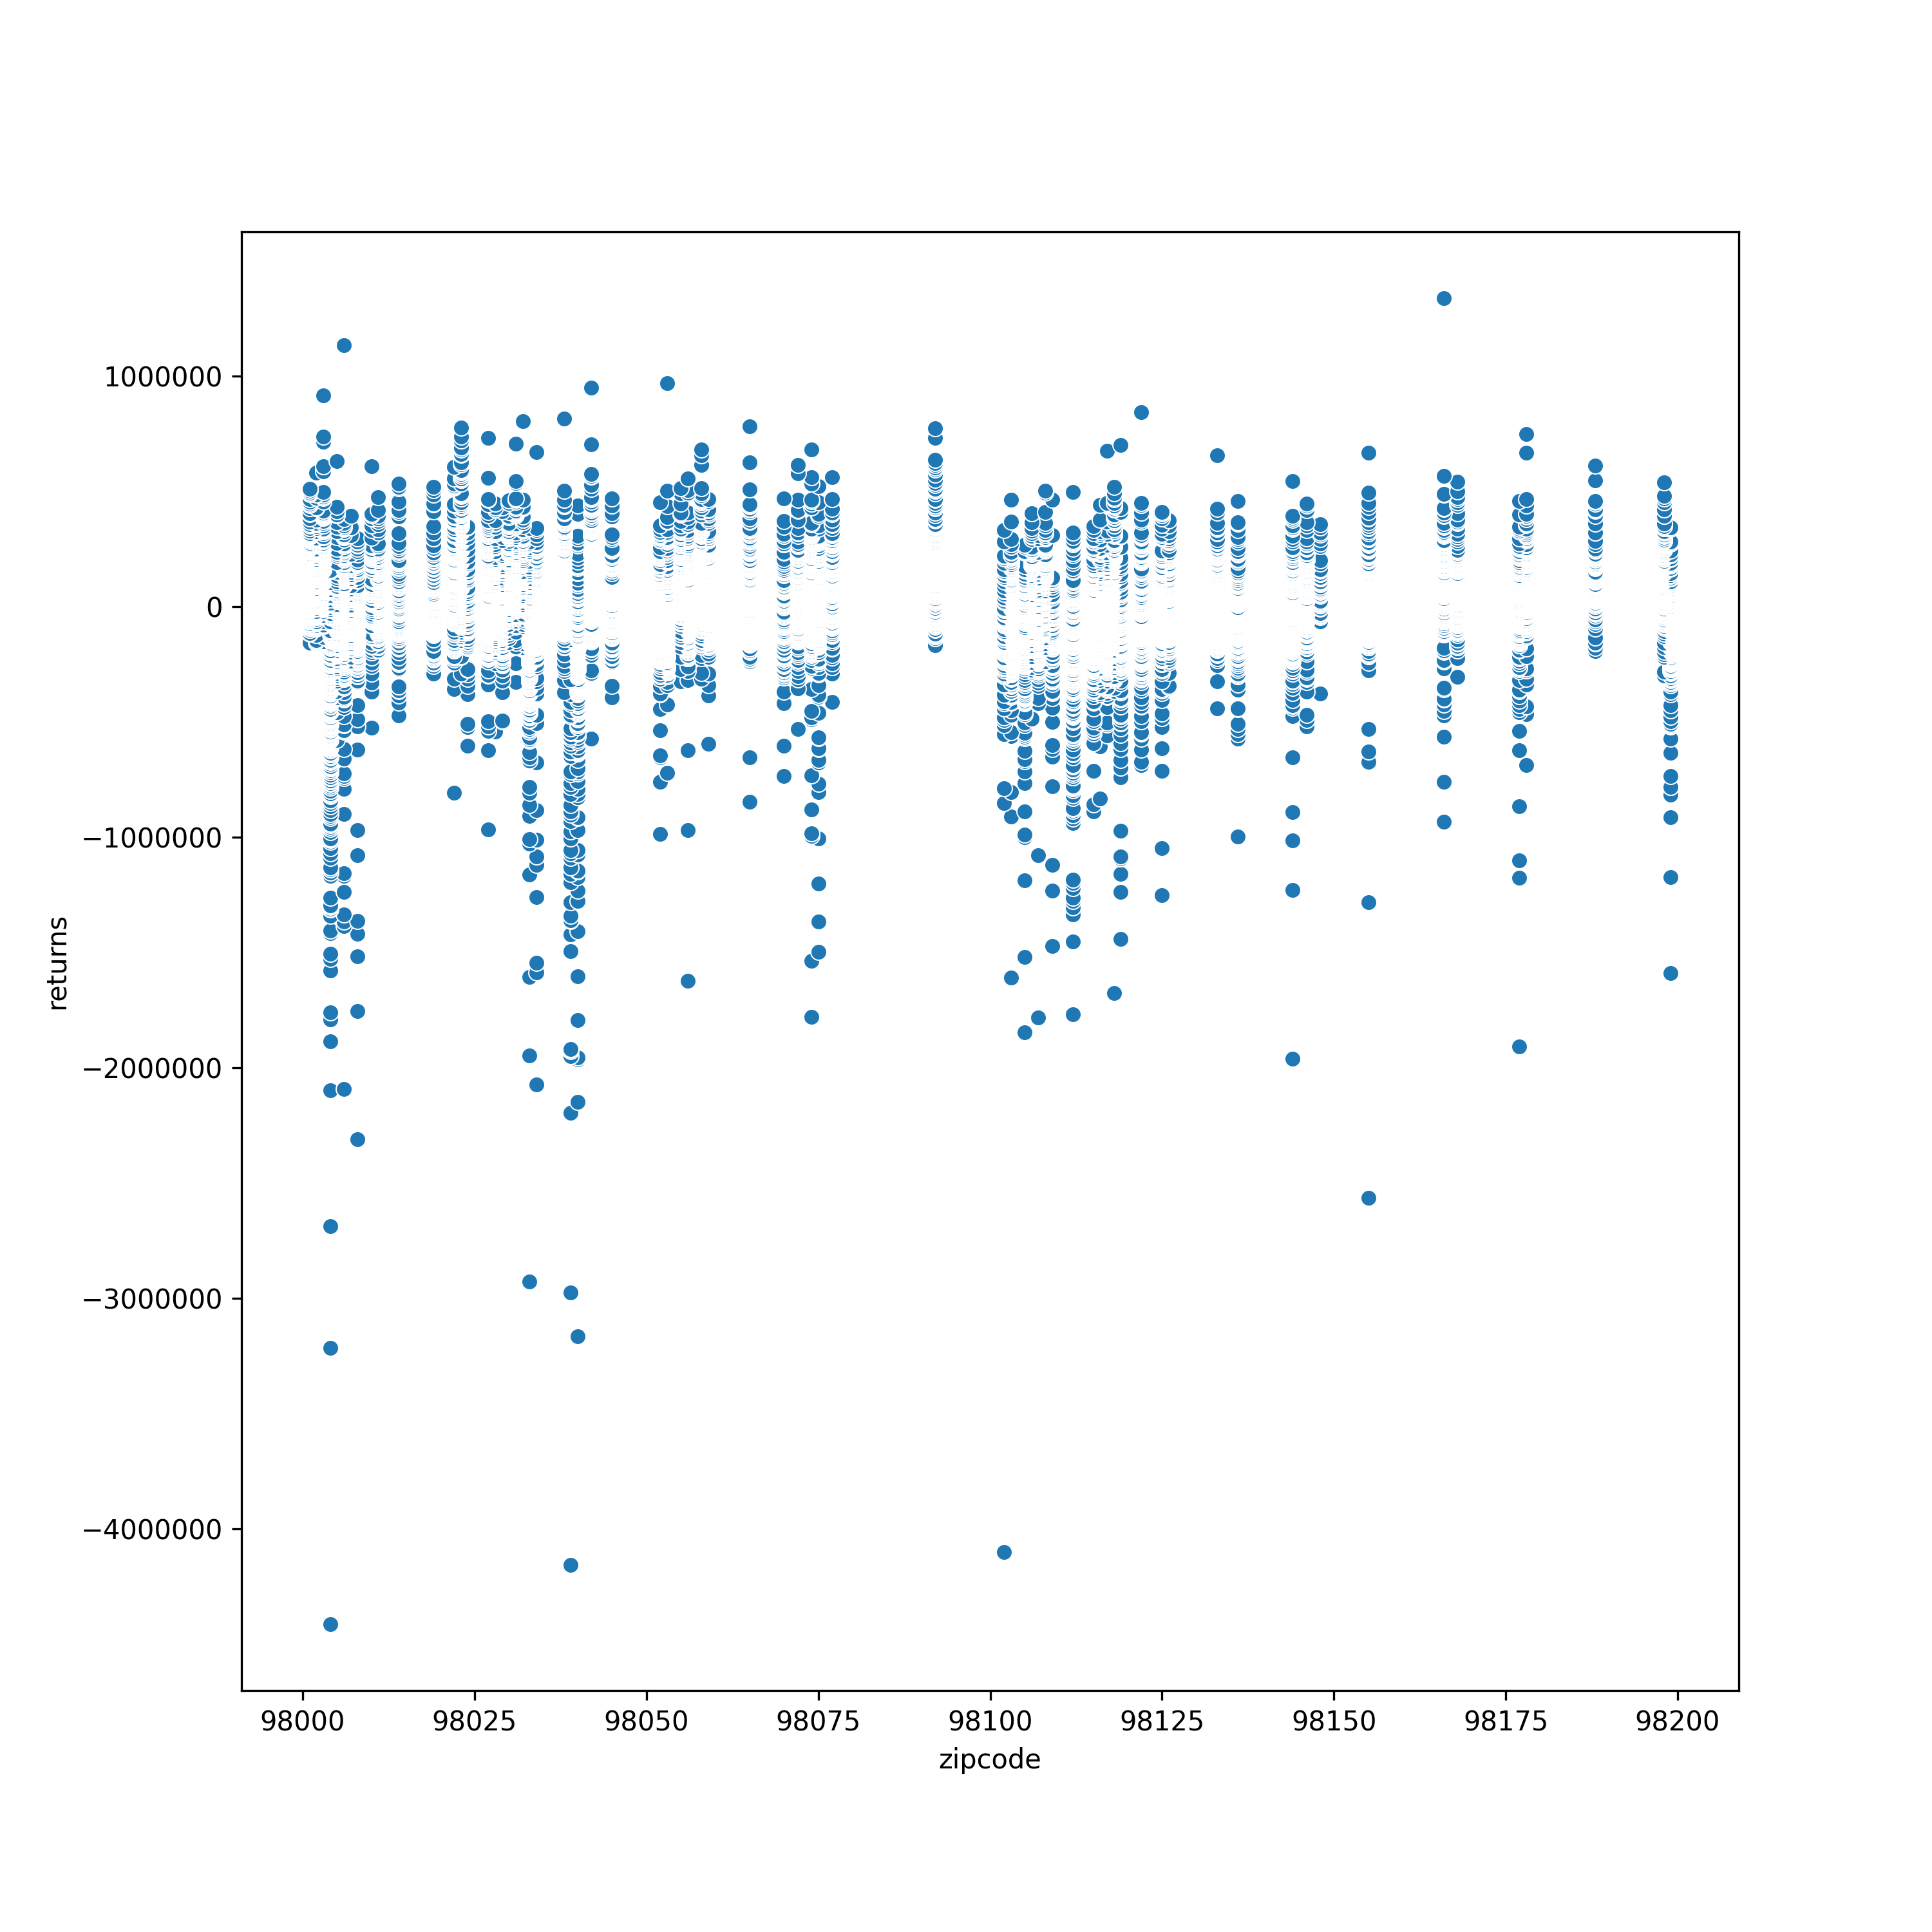
<number>
5. Regression modelling – Plotting the returns

Slide 12
The top 5 properties with max returns are below:
Zip code Returns Bedrooms
1. 98166 1,339,565.0 7
2. 98045 1,136,496.3 5
3. 98134 970,928.9 7
4. 98345 950,307.0 4
5. 98121 918,622.6 5

